Slide 1
Kids Fight Climate Change
By Martin Dorey
T: 020 7587 1842
W: literacytrust.org.uk
Twitter: @Literacy_Trust
Facebook: nationalliteracytrust

Slide 2
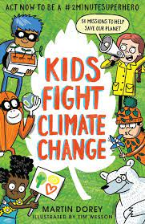
LO: make inferences based on a front cover
The front cover:
Let’s look at the front cover as a class and think about these questions.
The background colour is green. What does this make you think of?
Who do you think this book is written for and why?
What other images can you see on the front cover?
Why do you think there are animals on the front cover?
Notes:
Start by looking at the front cover with your class, you could also read the blurb. Encourage discussion around the images and colours used to begin to develop inferences and links as to what the book may be about.

Slide 3
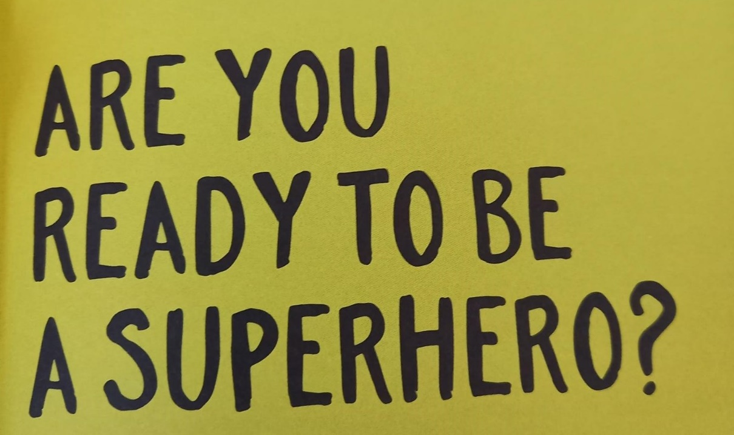
LO: make inferences based on a front cover
Let’s read the first few pages.
What does the word superhero make you think of?
Why do you think the writer has asked the reader a question?
Notes:
Read pages 7 – 9 with your class. Lower key stages could discuss the imagery of green, explain what a superhero looks like. Higher key stages could look at the use of a rhetorical question and discuss its effect on the reader.

Slide 4
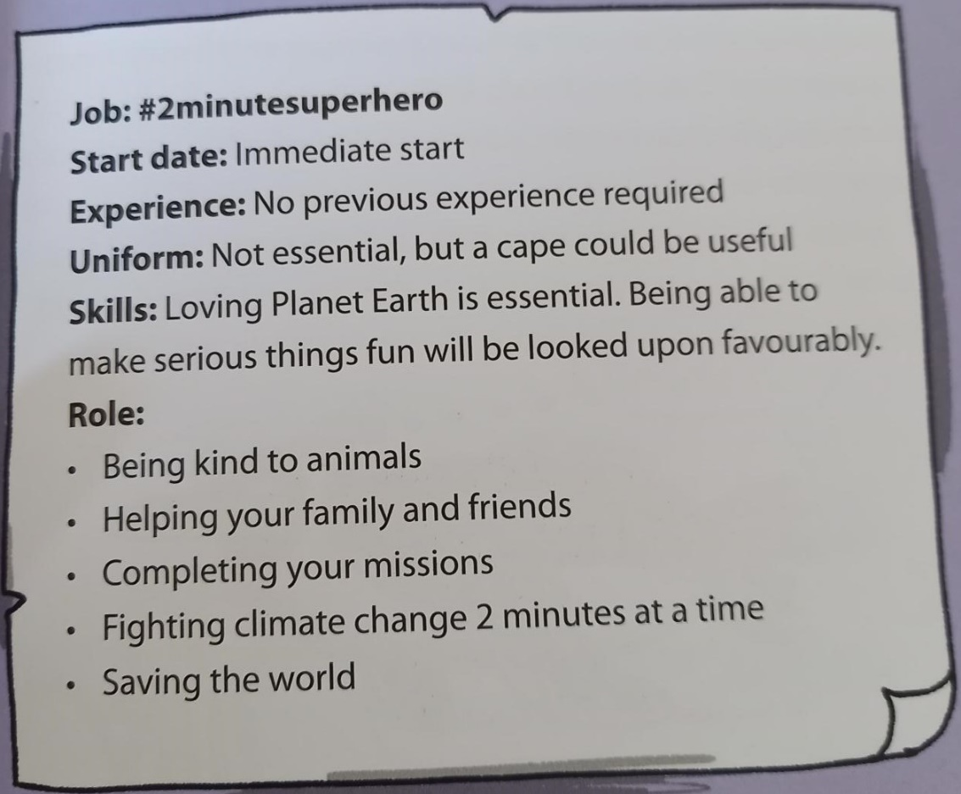
LO: make inferences based on a front cover
Is there a uniform? Why might you need this?
When is the start date for the job of #2minutesuperhero?
What skills are needed for the job?
Look at the list of tasks for the role. Which one do you think you will be the best at and why?
Notes:
Use these questions to encourage discussion about the content of the first few pages of the book.
Lower key stages could focus on the use of a ‘cape’ and the skills needed for the ‘job’. Pupils might notice the use of listing or bullet points to portray key information.
Higher key stages could discuss how a ‘job advert’ engages a reader and encourages action or involvement.
Pupils could also focus on what other skills superheroes need. You could discuss examples of when they have done brave or kind acts.

Slide 5
LO: make inferences based on a front cover
Why do you think Martin Dorey has written this book?
Choose one of the sentences below to answer the question.
LO: make inferences based on a front cover
I think the author has written this book to ……. I think this because of the … on the front cover.
I think the author has written this book to ……. I think this because the writer has used…
Notes:
The plenary of this lesson is to produce an inference based on the front cover, or the text for higher key stages.
Use the sentence starters as scaffolding. This could be a verbal activity or written on post it notes and used as part of a display around climate change, or written in books.
Challenge higher key stage pupils to consider how the author intended the reader to involve themselves in the book, complete challenges and act on the information detailed throughout the book.
Lower key stages might infer that the book is about nature because of the colour green or the pictures of plants.

