Slide 1
Heroes & heroines
story writing competition
If you have any questions, do get in touch:
birminghamstories@literacytrust.org.uk
birminghamstories.org.uk
#BirminghamStories
https://www.instagram.com/bhamstories/
Notes:
Please adjust this ppt as you see fit!

Slide 2
Who’s your favourite hero or heroine?
Notes:
3 minutes
Hand out this slide or display and use whiteboards

Slide 3
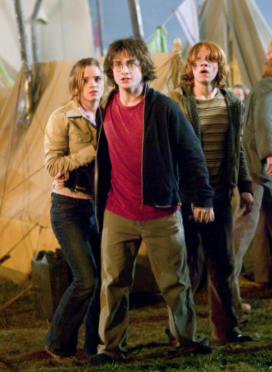
Who’s your favourite hero or heroine?
Harry Potter and the Goblet of Fire, 2015, Warner Bros.
The Secrets of the Henna Girl, 2012, Sufiya Ahmed, Penguin
The Personal History of David Copperfield, 2020, Searchlight Pictures

Slide 4
What makes a hero?
What qualities do heroes have?
What are their abilities?
What situations do they encounter?
What happens in their stories?
Can you tell from the beginning whether a character will turn out to be the hero of the story?
Is being a hero a full-time activity? Can there be heroes who also have villainous qualities?
What different types of heroes can you think of?
Will the qualities be different for heroes and heroines?

Slide 5
Match the adjectives with their definitions
Do now task: Adjectives tell us about qualities of people
Illiterate
Neglected
Exploited
Ignorant
Irreligious
Malnourished
Carefree
Convivial
Tolerant
Innocent
Uncared for, mistreated
Godless
Cheerful and free from care
Used unfairly
Unaware and/or rude
Friendly and warm
Uneducated, unable to read or write
Accepting, easy-going
Underfed, hungry
Unknowing, blameless
Finished? Mark the words that are negative with N and words that are positive with P

Slide 6
Answers
Illiterate G
Neglected A
Exploited D
Ignorant E
Irreligious B
Malnourished I
Carefree C
Convivial F
Tolerant H
Innocent J
Uneducated, unable to read or write
Uncared for, mistreated
Used unfairly
Unaware and/or rude
Godless
Underfed, hungry
Cheerful and free from care
Friendly and warm
Accepting, easy-going
Unknowing, blameless

Slide 7
Read together
Once upon a time there was a little chimney-sweep, and his name was Tom. That is a short name, and you have heard it before, so you will not have much trouble in remembering it. He lived in a great town in the North country, where there were plenty of chimneys to sweep, and plenty of money for Tom to earn and his master to spend. He could not read nor write, and did not care to do either; and he never washed himself, for there was no water up the court where he lived. He had never been taught to say his prayers. He never had heard of God, or of Christ, except in words which you never have heard, and which it would have been well if he had never heard. He cried half his time, and laughed the other half. He cried when he had to climb the dark flues, rubbing his poor knees and elbows raw; and when the soot got into his eyes, which it did every day in the week; and when his master beat him, which he did every day in the week; and when he had not enough to eat, which happened every day in the week likewise. And he laughed the other half of the day, when he was tossing halfpennies with the other boys, or playing leap-frog over the posts, or bowling stones at the horses’ legs as they trotted by, which last was excellent fun, when there was a wall at hand behind which to hide. As for chimney-sweeping, and being hungry, and being beaten, he took all that for the way of the world, like the rain and snow and thunder, and stood manfully with his back to it till it was over, as his old donkey did to a hail-storm; and then shook his ears and was as jolly as ever; and thought of the fine times coming, when he would be a man, and a master sweep, and sit in the public-house with a quart of beer and a long pipe, and play cards for silver money, and wear velveteen and ankle-jacks, and keep a white bull-dog with one gray ear, and carry her puppies in his pocket, just like a man. And he would have apprentices, one, two, three, if he could. How he would bully them, and knock them about, just as his master did to him; and make them carry home the soot sacks, while he rode before them on his donkey, with a pipe in his mouth and a flower in his button-hole, like a king at the head of his army. Yes, there were good times coming; and, when his master let him have a pull at the leavings of his beer, Tom was the jolliest boy in the whole town.
Illiterate
Neglected
Exploited
Ignorant
Irreligious
Malnourished
Carefree
Convivial
Tolerant
Innocent
Notes:
HO Kingsley annotated text

Slide 8
Language devices
Notice how Kingsley does not use any of the words in our list of adjectives? He uses other devices to draw us in.
Once upon a time there was a little chimney-sweep, and his name was Tom. That is a short name, and you have heard it before, so you will not have much trouble in remembering it. He lived in a great town in the North country, where there were plenty of chimneys to sweep, and plenty of money for Tom to earn and his master to spend. He could not read nor write, and did not care to do either; and he never washed himself, for there was no water up the court where he lived. He had never been taught to say his prayers. He never had heard of God, or of Christ, except in words which you never have heard, and which it would have been well if he had never heard. He cried half his time, and laughed the other half. He cried when he had to climb the dark flues, rubbing his poor knees and elbows raw; and when the soot got into his eyes, which it did every day in the week; and when his master beat him, which he did every day in the week; and when he had not enough to eat, which happened every day in the week likewise. And he laughed the other half of the day, when he was tossing halfpennies with the other boys, or playing leap-frog over the posts, or bowling stones at the horses’ legs as they trotted by, which last was excellent fun, when there was a wall at hand behind which to hide. As for chimney-sweeping, and being hungry, and being beaten, he took all that for the way of the world, like the rain and snow and thunder, and stood manfully with his back to it till it was over, as his old donkey did to a hail-storm; and then shook his ears and was as jolly as ever; and thought of the fine times coming, when he would be a man, and a master sweep, and sit in the public-house with a quart of beer and a long pipe, and play cards for silver money, and wear velveteen and ankle-jacks, and keep a white bull-dog with one gray ear, and carry her puppies in his pocket, just like a man. And he would have apprentices, one, two, three, if he could. How he would bully them, and knock them about, just as his master did to him; and make them carry home the soot sacks, while he rode before them on his donkey, with a pipe in his mouth and a flower in his button-hole, like a king at the head of his army. Yes, there were good times coming; and, when his master let him have a pull at the leavings of his beer, Tom was the jolliest boy in the whole town.
Syndeton – list of words using a conjunction (here ‘and’) to join the words, emphasising their connection
Anaphora – repetition of word or words at the start of a clause or phrase – here to emphasise Tom’s ignorance and unhappiness
Epistrophe – repetition of a word or words at the end of a clause or phrase – here to emphasise that this happens every day to Tom
Zeugma – where one word or phrase (here ‘plenty of money’) affects two parts of a sentence. It makes the reader pause and focus on the meaning of the sentence – it’s often funny or sad. Another example is ‘he stole her heart and her iPhone’
He also directly addresses the reader – ‘you’
He opens the story as though it is a fairy tale using ‘once upon a time’, making it seem like a story for all time, a story we are all familiar with
He also makes Tom a likeable and positive character who is optimistic even when his life is hard, or his beliefs mistaken
He is the hero of the story and so we must like him and want him to do well
Notes:
Get pupils to annotate the extract to note the devices on the extract – perhaps colour code them
This slide can be printed for pupils who struggle to keep pace, see also HO Kingsley annotated text
(10 minutes – running total 20 minutes)

Slide 9
Try it out!
Have a go at changing these sentences by adding the devices we have just looked at. Or try writing your own.
Syndeton – list of words using a conjunction to join the words, emphasising their connection
Anaphora – repetition of word or words at the start of a clause or phrase – here to emphasise a point or idea
Epistrophe – repetition of a word or words at the end of a clause or phrase – here to emphasise a point or idea
Zeugma – where one word or phrase (here plenty of money) affects two parts of a sentence. It makes the reader pause and focus on the meaning of the sentence – often to make them smile, but not always
Directly addresses the reader – ‘you’ Opens the story as though it is a fairy tale using ‘once upon a time’ making it seem like a story for all time, a story we are all familiar with. Creates a likeable and positive character who is optimistic. Makes them the hero of the story – we like them and want them to do well
Turn these sentence into one sentence, using syndeton: I like apples. I like bananas. I like oranges. I like strawberries. Best of all, I like fruit salad!
Use anaphora to emphasise three things that that you would never do (e.g. ‘I would never…’)
Use epistrophe to emphasise that all of these things happen ‘today, in our city’: charity, kindness, community spirit
Use zeugma to make your reader look again. Finish this sentence: The storm destroyed my home and… (consider choosing something that is very different to a home - such as a feeling or something of differing importance)
Write a sentence beginning, ‘Once upon a time’ about a hero or heroine. Directly address the reader (‘you’) and make the reader like them and respond to them

Slide 10
Example answers
Syndeton – list of words using a conjunction to join the words, emphasising their connection
Anaphora – repetition of word or words at the start of a clause or phrase – here to emphasise a point or idea
Epistrophe – repetition of a word or words at the end of a clause or phrase – here to emphasise a point or idea
Zeugma – where one word or phrase (here plenty of money) affects two parts of a sentence. It makes the reader pause and focus on the meaning of the sentence – often to make them smile, but not always
Directly addresses the reader – ‘you’ Opens the story as though it is a fairy tale using ‘once upon a time’ making it seem like a story for all time, a story we are all familiar with. Creates a likeable and positive character who is optimistic. Makes them the hero of the story – we like them and want them to do well
I like apples and bananas and oranges and strawberries and, best of all, I like fruit salad!
“Never gonna give you up, never gonna let you down, never gonna run around or hurt you.”
There are works of charity happening today, in our city. There are acts of kindess happening today in our city. There is community spirit, all around, today in our city! (Doesn’t it make our city sound great?)
The storm destroyed my home and my hairstyle The storm destroyed my home and my reputation The storm destroyed my home and my friendship
Once upon a time there was a child called Kiz. When life was hard, which it always was, Kiz just laughed. You know the type of child I mean – Kiz always shared their sweets and never picked their nose.
Notes:
Self assess / share good examples

Slide 11
The Water Babies
Reverend Charles Kingsley, a Victorian Cambridge history professor first published his book in 1863, but it first appeared in serial parts from 1862–63 in Macmillan’s Magazine. It highlights the terrible lives of child chimney sweeps during this period
Many other people wrote articles, objected in Parliament, and publicly complained about the working conditions and lives led by such children. But it was this book – a story – that really opened the public’s eyes and hearts to the chimney sweeps’ plight
This is the power of a story
Notes:
IMAGE FROM BRITISH LIBRARY https://www.bl.uk/collection-items/charles-kingsleys-the-water-babies PUBLIC DOMAIN
Read to class – 2 minutes (running total 22 minutes)

Slide 12
Using language effectively to create characters (from Cermakova & Mahlberg 2019)
When describing a character, the language you use is important to make the description vivid or to highlight specific features that will become relevant as the story develops.
Language is a key tool for story writing. It allows you to create images in the reader’s mind and bring characters to life.

Slide 13
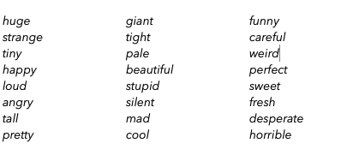
Adjectives
As the Kingsley example shows, there are a range of devices to show the qualities of people. It’s not always adjectives that are used, but they still do play an important role. Here are some examples of adjectives that are frequently used to describe people, things and places.

Slide 14
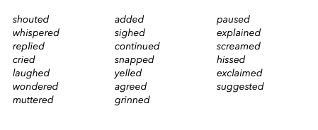
Speech verbs
The way characters speak gives you clues about what they are like. Are they timid and whisper? Or are they loud and shout? The most frequently used speech verb is said. But there is a variety of other verbs that you can use to create specific effects.

Slide 15
The eyes as the mirror of the soul
We sometimes say that the eyes are the mirror of the soul. The way characters are described when ‘looking’ at someone or something is an important clue. They can glance, stare, gaze etc. All of these verbs have slightly different meanings. The narrator can also describe the eyes directly. Can you tell how the meaning of ‘looking’ is different in these three examples from Oliver Twist?
'Ay?' said Monks, with quivering lip, and glancing over his shoulder, 'Blood! How things come about!’
There was a back-garret window with rusty bars outside, which had no shutter; and out of this, Oliver often gazed with a melancholy face for hours together
'What! You're afraid of our getting the better of you, are you?' inquired Sikes, fixing his eyes on the Jew. 'Ugh!'
Notes:
See HO Techniques of characterisation

Slide 16
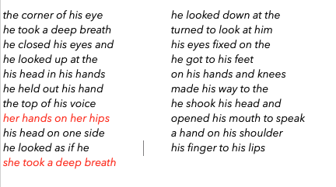
Body language
Descriptions of ‘looking’ are descriptions of the body language of characters. Body language is crucial for the creation of fictional people. There are a number of typical behaviours that can be observed in stories. Here are some examples of phrases found in a number of stories. Notice that most of them describe male characters. Do you have any idea why this might be the case?

Slide 17
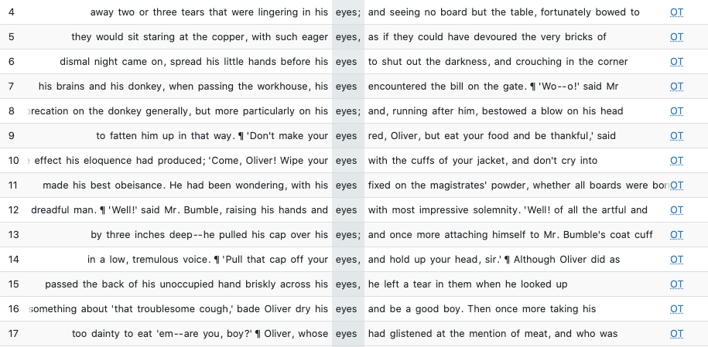
Techniques for creating characters
It’s useful to carefully observe what successful authors do. Reading lots of stories will give you plenty of practice! Additionally, you can research frequently used words to find out how people in fiction are described. Below are examples of how Dickens uses the word eyes in Oliver Twist. What can you observe?
Notes:
See HO Characterisation techniques

Slide 18
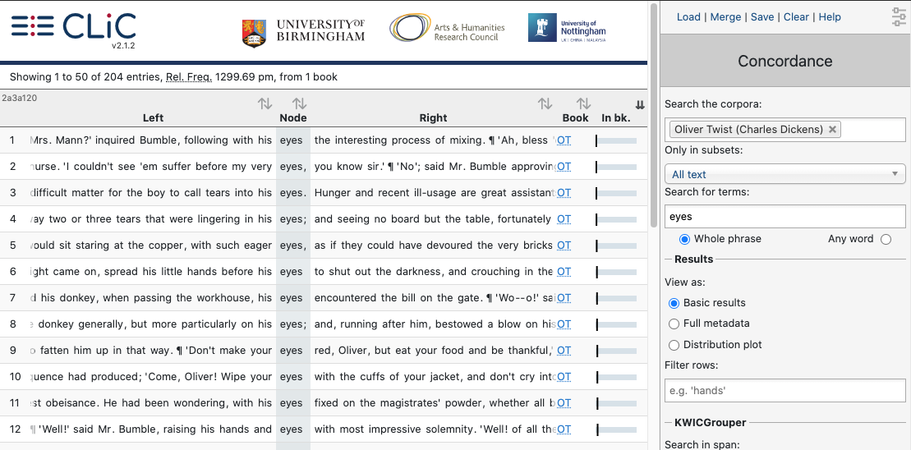
If you want to do more research yourself, here is how:
Go to clic.bham.ac.uk. The screen shot shows you how you can get examples for eyes in Oliver Twist, but you can search many more books for examples of potentially useful story words.
Notes:
See HO characterisation techniques

Slide 19
Task: YOU are going to write a story
You are going to write a story of 500-750 words
You should create a hero or heroine who your reader can respond to
You should, like Kingsley, use language devices to make your reader pay attention and to create a gripping hero / heroine
You might, like Kingsley, want to draw attention to a situation or lifestyle
Use the planning sheets to help you plan your hero / heroine and your story arc
There are also other worksheets to help you with your writing including some guidance on doing your own research on character descriptions.

Slide 20
What will your hero / heroine be like?
What’s their backstory?
What are their strengths or special skills?
What do they look like?
What’s their name?
What’s their body language like?
Do they have any weaknesses?
How do they speak? What do they sound like?
Do they have family / friends?
Notes:
HO Character planning

Slide 21
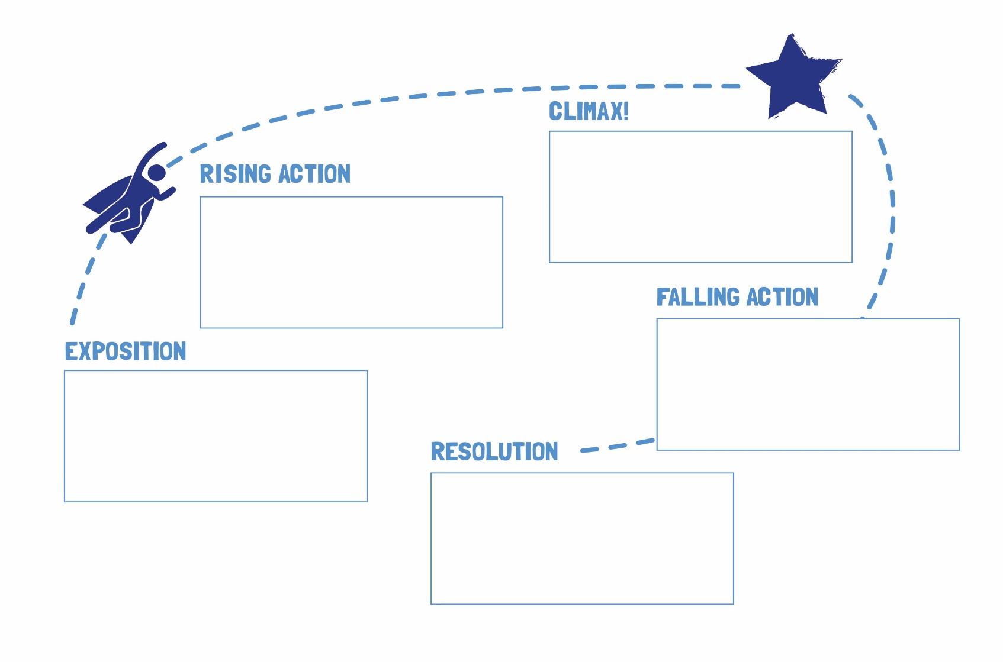
Stories follow an arc
You show what your hero / heroine experiences over a period of time - where things happen, where problems have to be solved, where the hero /heroine encounters other characters (people, animals, ghosts, etc.)

Slide 22
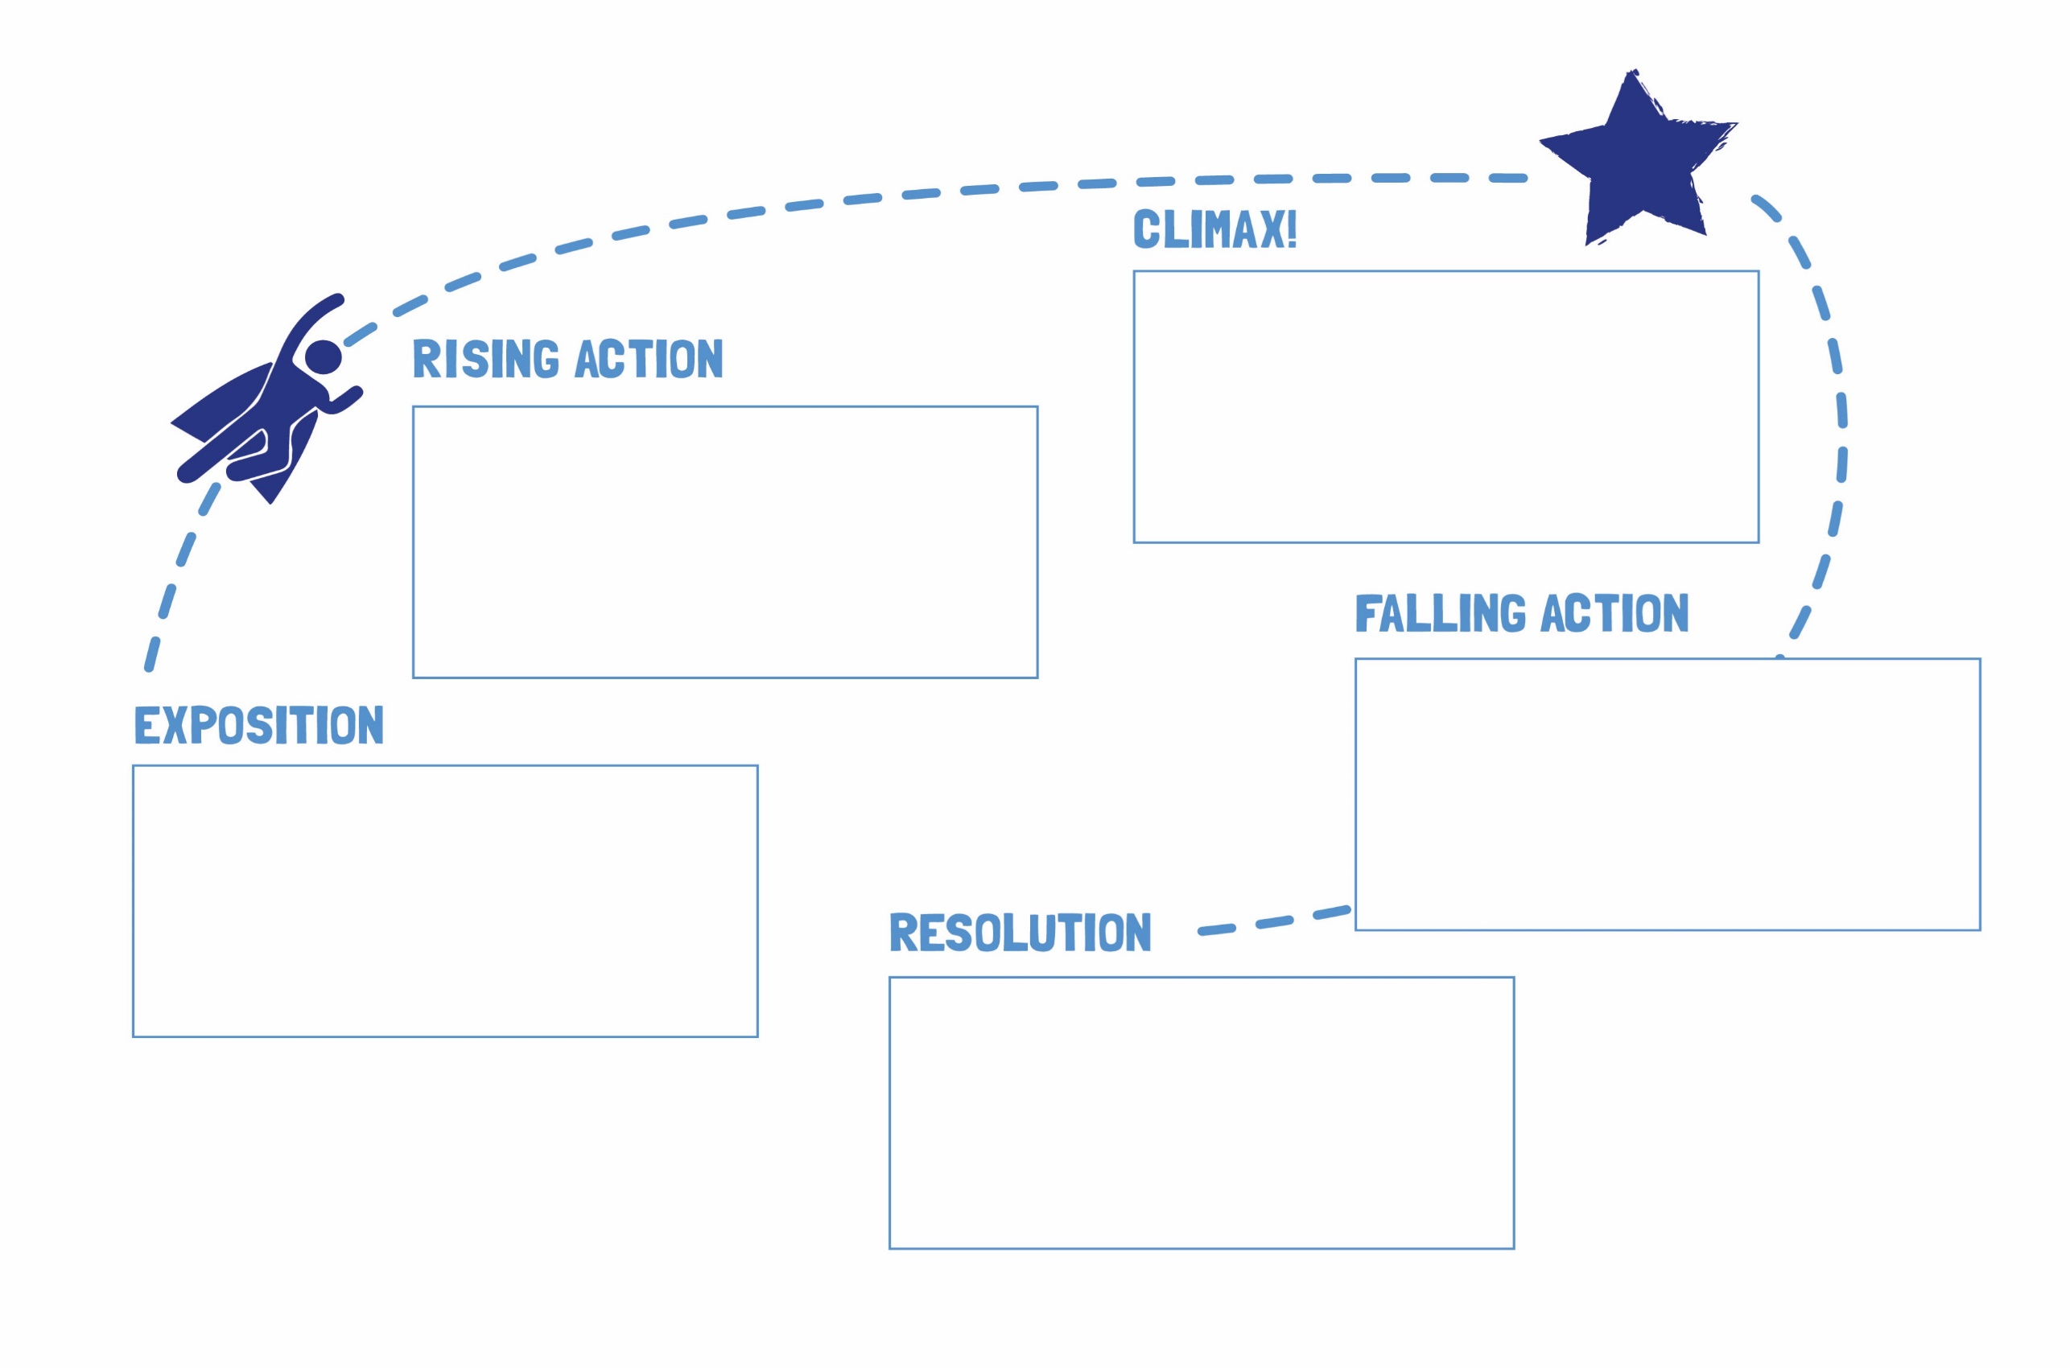
Stories follow an arc
Grandma reveals herself to be the wolf!
Luckily, a passing woodcutter hears the screams and kills the wolf
She goes off the path and meets a wolf. She tells the wolf about her mission.
She reaches her grandma’s cottage and notices several ‘big’ things about grandma. Finally she notices her BIG TEETH
There was a little girl who lived near a forest and she loved to wear a red riding hood.
TRIGGER: One day, she walks alone through the woods to visit her grandma – she must stay on the path!
The woodcutter cuts opens the wolf to reveal grandma (unchewed)
Little Red Riding Hood promises to stay on the path forever more!
Notes:
HO story arc planning

Slide 23
Language can help signpost the arc of your story
Openings:
There was a little girl who lived near a forest and she loved to wear a red riding hood.
Once upon a time there was a little chimney-sweep
Lucy lived with her parents near a forest.
Trigger: One day, she walks alone through the woods to visit her grandma.

Slide 24
Here is a different opening, can you describe how it works?
The Signalman - Charles Dickens
'Halloa! Below there!'
When he heard a voice thus calling to him, he was standing at the door of his box, with a flag in his hand, furled round its short pole. One would have thought, considering the nature of the ground, that he could not have doubted from what quarter the voice came; but, instead of looking up to where I stood on the top of the steep cutting nearly over his head, he turned himself about and looked down the Line. There was something remarkable in his manner of doing so, though I could not have said, for my life, what. But, I know it was remarkable enough to attract my notice, even though his figure was foreshortened and shadowed, down in the deep trench, and mine was high above him, so steeped in the glow of an angry sunset that I had shaded my eyes with my hand before I saw him at all.

Slide 25
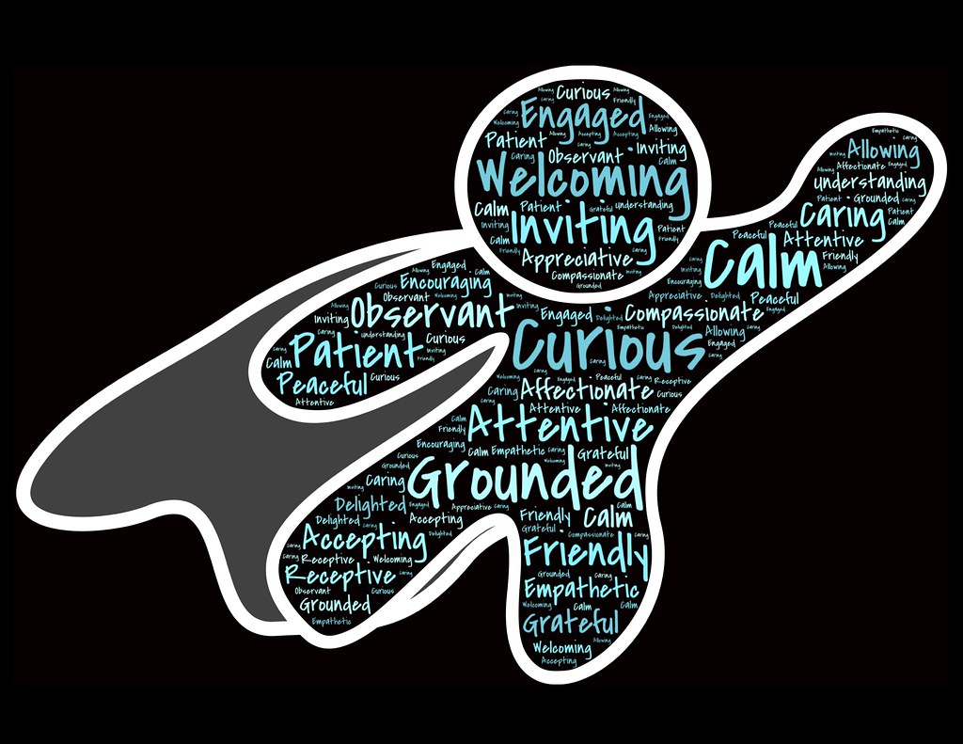
Remember
The reader must care about the hero / heroine in your story
Proofread your work and only submit your best work
Make good use of the story arc and language devices to depict characters
Your story can be no more than 750 words (as a guide, the extract from The Water Babies is 470 words long)
Deadline: 4 December 2020

Slide 26
Examples of resources
Three short videos: ‘Dismantling stories’, talking about achieving authentic dialogue, body language, and the impact of the intended audience
https://www.birmingham.ac.uk/schools/edacs/news/2019/dismantling-stories.aspx
BBC Bitesize ‘Fiction Writing’ https://www.bbc.co.uk/bitesize/topics/zn8tkmn
How to write a female villain worksheets https://tinyurl.com/y3zf27qy
Litdrive resources for teachers https://litdrive.org.uk/
Comma Press ‘Understanding the Short Story’ https://commapress.co.uk/resources/

Slide 27
These resources have been created by
Sarah Barrington (University of Birmingham School) & Michaela Mahlberg (University of Birmingham).
We are grateful for valuable feedback from Jim Bryant, Chris Dolby, Nathan Duck, Jessica Lee and Sarah McMurchy.

