Slide 1
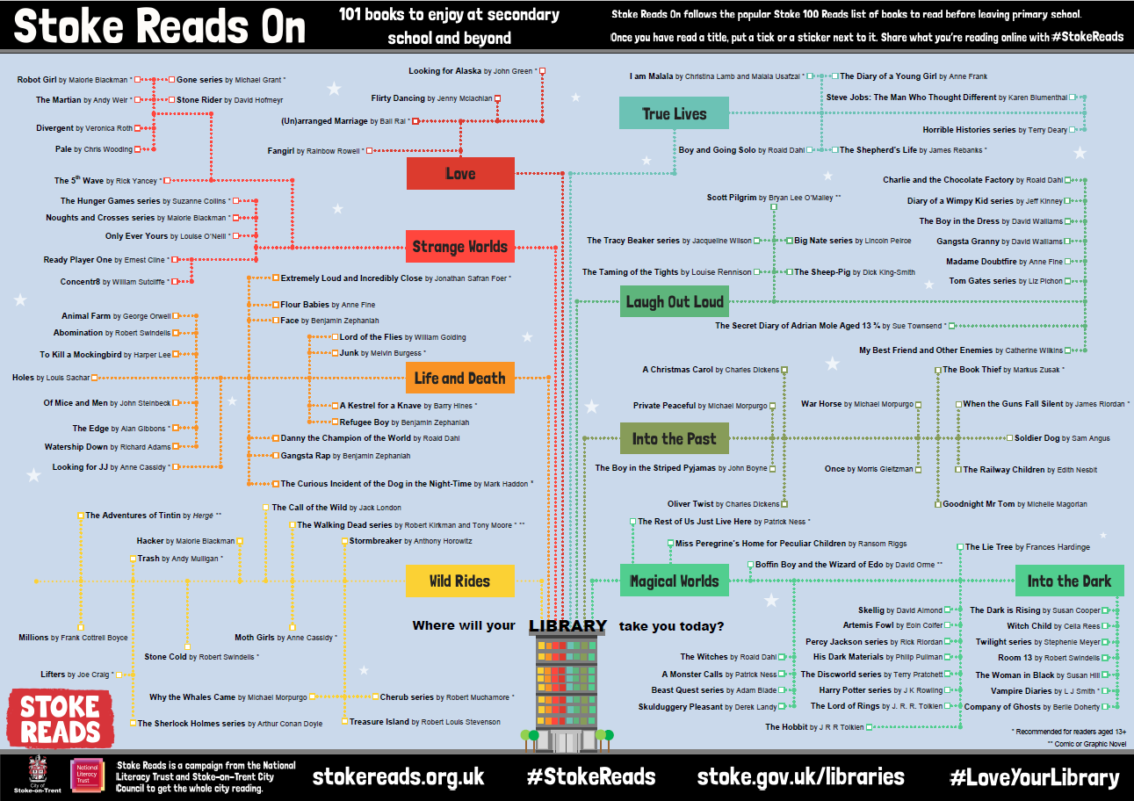
Are you reading books on the Stoke Reads On list?
You will receive a certificate and prize when you:
Read your first book on the list
Read every title in one genre
Finish every book on the list!
Bring your reading log or Stoke Read On poster to_________________
#StokeReads
stokereads.org.uk
stoke.gov.uk/libraries

