Slide 1
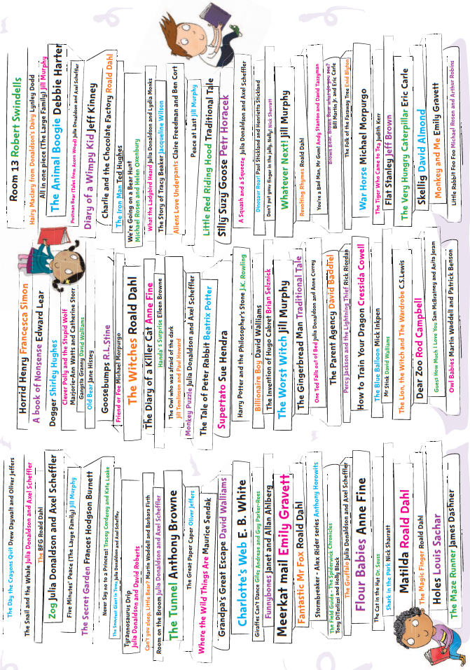
Stoke 100 Reads
Reading log
Name:
Class:

Slide 2
 | Title | Author | Rating *****
1
2
3
4
5
6
7
8
9
10
 | Title | Author | Rating *****
11
12
13
14
15
16
17
18
19
20

Slide 3
 | Title | Author | Rating *****
21
22
23
24
25
26
27
28
29
30
 | Title | Author | Rating *****
31
32
33
34
35
36
37
38
39
40

Slide 4
 | Title | Author | Rating *****
41
42
43
44
45
46
47
48
49
50
 | Title | Author | Rating *****
51
52
53
54
55
56
57
58
59
60

Slide 5
 | Title | Author | Rating *****
61
62
63
64
65
66
67
68
69
70
 | Title | Author | Rating *****
71
72
73
74
75
76
77
78
79
80

Slide 6
 | Title | Author | Rating *****
81
82
83
84
85
86
87
88
89
90
 | Title | Author | Rating *****
91
92
93
94
95
96
97
98
99
100

